Slide 1
Sheridan Walk-in Clinic Management System
AlGhotmy, ahmed id 991500313
Tee , Clinton id 991482737
Object Oriented Programming 2 Java (PROG 24178-Section 44738/45005)

Slide 2
Table of content
Introduction and tool capability
Tool uml diagram map (Demo)
Conclusion and outcome

Slide 3
Introduction and Tools features and capabilities
Sheridan walk-in clinic management system is used by walk-in clinic staff to manage patients data
The tool writes on and reads from a text file
The tool allows the user to
login using a secured username and password
Add/edit/delete/search patients

Slide 4

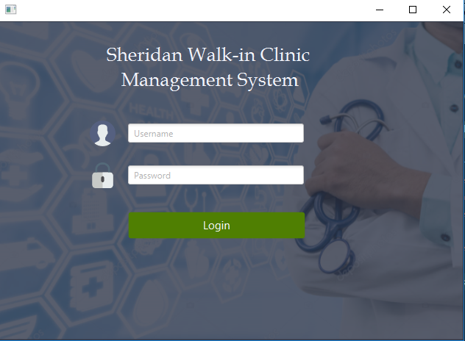
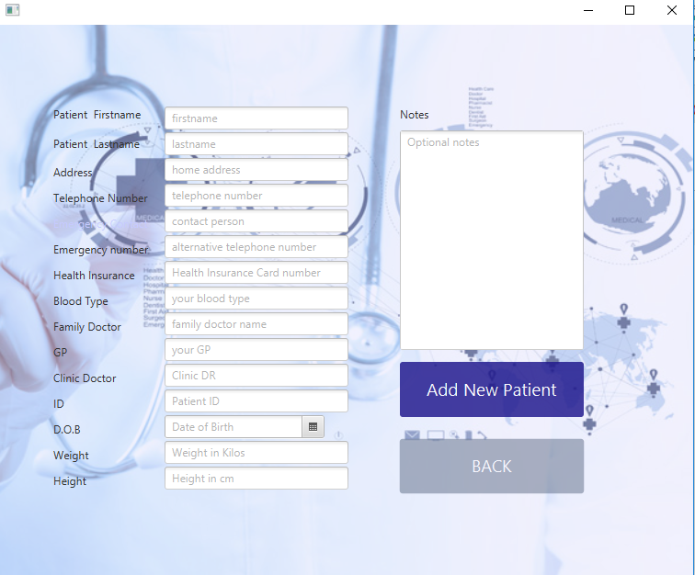
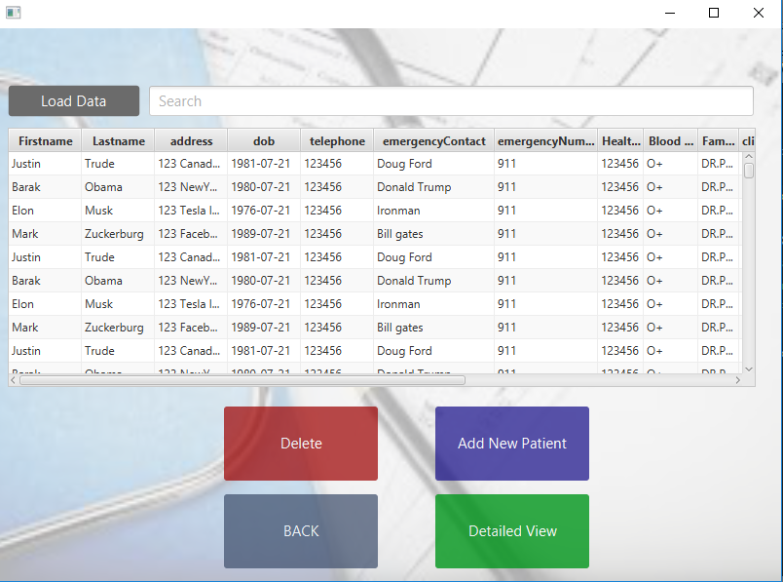
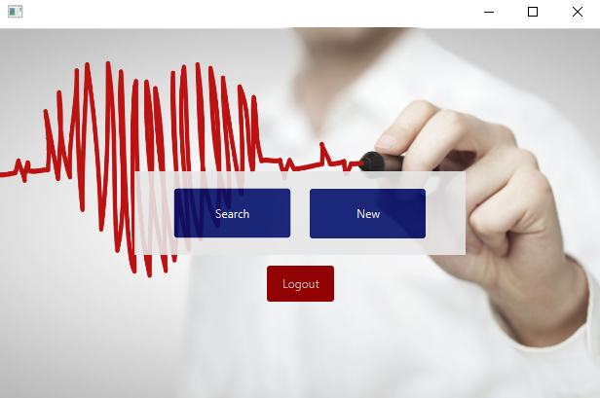
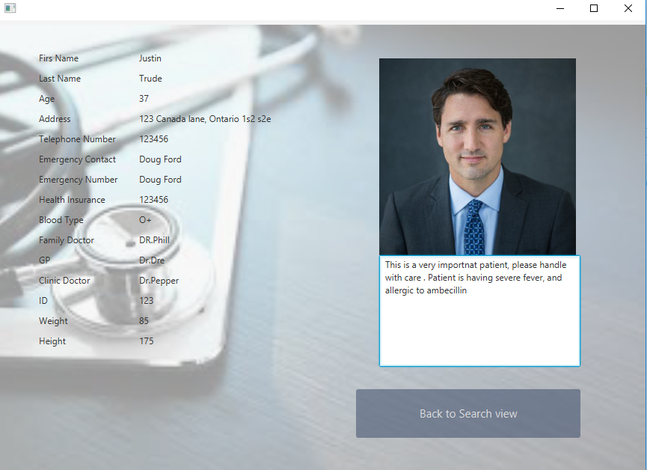
UML Application map + demo
4.Save on/Read from file
1. Login
2.1 Add new
2.2 Search View
3 Detailed View
2. Search/Add New

Slide 5
Conclusion and outcomes
The tool assumes the data confidentiality of the patients using secure login name and password
staff/users van add, edit, delete, and search patients
alert box is prompting confirmation when editing and/or deleting data
Smart search ignoring case sensitive input and uses auto complete feature

